Slide 1
Object Oriented Analysis and Design (OOA&D)

Slide 2
What Is an Object?
• Definition: An object is a software bundle of
variables and related methods.
• As the name object-oriented implies, objects are
key to understanding object-oriented technology.
• You can look around you now and see many
examples of real-world objects: your dog, your
desk, your television set, your bicycle.
• Software objects are modeled after real-world
objects in that they, too, have state and behavior.
• A software object maintains its state in variables and
implements its behavior with methods.

Slide 3
WHY OBJECT ORIENTATION
OO Methods enables to develop set of objects that work together software similar to traditional techniques.
some key reasons why object orientation is emphasized in OOAD:

Slide 4
1. Modeling Real-World Entities:
Object-oriented systems are designed to model the real-world entities and their interactions.
Objects in the software model represent tangible or conceptual entities, and the relationships between objects mirror real-world associations.
This makes it easier for stakeholders to understand and relate to the software system.

Slide 5
2. Abstraction
Abstraction is a crucial concept in OOAD. Objects allow developers to abstract complex systems by focusing on essential features while hiding unnecessary details.
This simplifies the modeling and design process, making it more intuitive and manageable.

Slide 6
3. Modularity
Modularity means breaking up something complex into manageable units
Modularity helps you to understand the complex system
Objects promote modularity by encapsulating data and behavior within discrete units.
Each object is responsible for a specific set of tasks, and interactions between objects occur through well-defined interfaces.

Slide 7
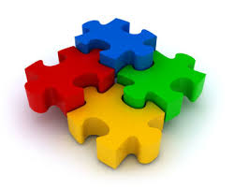
3. Modularity Con…
This modularity enhances code organization, understandability, and maintainability.
diagram

Slide 8
4. Encapsulation
Encapsulation involves bundling data and the methods that operate on the data into a single unit (an object).
This helps in hiding the internal details of an object, exposing only what is necessary for other objects to interact with it.
Encapsulation supports data security and promotes a clear separation of concerns.

Slide 9
5. Inheritance
Inheritance allows the creation of new classes based on existing classes, inheriting their attributes and behaviors.
This promotes code reuse, reduces redundancy, and facilitates the creation of a hierarchy of classes.
Inheritance contributes to the extensibility and flexibility of the software system.

Slide 10
6. Polymorphism
Polymorphism enables objects of different types to be treated as objects of a common type.
This allows for flexibility and extensibility in the system.
Polymorphism is often achieved through mechanisms like method overriding and interfaces, enabling the same interface to be implemented by multiple classes.
Notes:
#include<iostream>
using namespace std;
class FirstClass{
public:
//virtual
void message(){
cout<<"FirstClass mehtod ";
}
};
class SecondClass: public FirstClass
{
public:
void message(){
cout<<"SecondClass method ";
}
};
int main(){
SecondClass ObjSecondClass;
// ObjSecondClass.message();
return 0;
}

Slide 11
7. Reusability
Object-oriented systems encourage the reuse of code.
Objects and classes can be reused in different parts of the system or in different projects, leading to more efficient and economical software development.
Reusability is a key aspect of OOAD that promotes productivity and reduces development time.

Slide 12
8. Adaptability to Change
OOAD supports the development of flexible and adaptable systems.
Changes to one part of the system can often be localized to specific classes or objects, reducing the impact on the overall system.
This adaptability is crucial in dynamic and evolving software environments.

Slide 13
9. Collaboration
Objects interact with each other through well-defined interfaces, promoting collaboration between different parts of the system.
This modular and collaborative approach makes it easier to understand and maintain complex systems.

Slide 14
Object-Orientation
Investigation of the Problem Logical Solution Code
• Object-oriented analysis. – Investigation that is object-centric.
• Object-oriented design. – Solution in terms of interacting software objects.
• Object-oriented programming. – Coding in an object-oriented programming language
Analysis
Design
Implementation

Slide 15
OVERVIEW OF UNIFIED APPROACH
The Unified Approach (UA) is a methodology for software development.
Combines with the object management groups in Unified Modelling Language.
UA utilizes the Unified Modeling Language (UML) which is a set of notations and conventions used to describe and model an application.

Slide 16
What is UML and Why we use UML?
UML → “Unified Modeling Language”
Language: express idea, not a methodology
Modeling: Describing a software system at a high level of abstraction
Unified: UML has become a world standard
Object Management Group (OMG): www.omg.org

Slide 17
A brief history of UML
UML is a visual graphical language for modeling various artifacts and interactions in a software system.
UML is now the widely adopted industry standard for visual modeling.
It is a visual language that helps us to analyze, document, construct, and most importantly, understand software systems.
It is a common visual language suitable for many different project stakeholders, such as architects, business analysts, software developers.
UML provides a time based interaction within a system, modeling classes, modeling deployment information.

Slide 18
What is UML and Why we use UML?
More description about UML:
It is an industry-standard graphical language for specifying, visualizing, constructing, and documenting the artifacts of software systems
The UML uses mostly graphical notations to express the OO analysis and design of software projects.
Simplifies the complex process of software design

Slide 19
What is UML and Why we use UML?
Why we use UML?
Use graphical notation: more clearly than natural language (imprecise) and code (too detailed).
Help acquire an overall view of a system.
UML is not dependent on any one language or technology.
UML moves us from fragmentation to standardization.

Slide 20
How to use UML diagrams to design software system?
Types of UML Diagrams:
Use Case Diagram
Class Diagram
Sequence Diagram
Collaboration Diagram
State Diagram
This is only a subset of diagrams … but are most widely used

Slide 21
Use-Case Diagrams
Use Case Diagrams are used to depict the functionality of a system or a part of a system.
A use-case diagram is a set of use cases
A use case is a model of the interaction between
External users of a software product (actors) and
The software product itself
More precisely, an actor is a user playing a specific role
describing a set of user scenarios
capturing user requirements
contract between end user and software developers

Slide 22
Use-Case Diagrams
Use Case
Boundary
Actor
Library System
Borrow
Employee
Client
Order Title
Fine Remittance
Supervisor

Slide 23
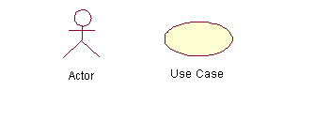
Use-Case Diagrams
Actors: A role that a user plays with respect to the system, including human users and other systems. e.g., inanimate physical objects (e.g. robot); an external system that needs some information from the current system.
Use case: A set of scenarios that describing an interaction between a user and a system, including alternatives.
System boundary: rectangle diagram representing the boundary between the actors and the system.

Slide 24
Use-Case Diagrams
Association:
communication between an actor and a use case; Represented by a solid line.
Generalization: relationship between one general use case and a special use case (used for defining special alternatives) Represented by a line with a triangular arrow head toward the parent use case.

Slide 25
Use-Case Diagrams
Include: a dotted line labeled <<include>> beginning at base use case and ending with an arrows pointing to the include use case. The include relationship occurs when a chunk of behavior is similar across more than one use case. Use “include” in stead of copying the description of that behavior.
<<include>>
Extend: a dotted line labeled <<extend>> with an arrow toward the base case. The extending use case may add behavior to the base use case. The base class declares “extension points”.
<<extend>>

Slide 26
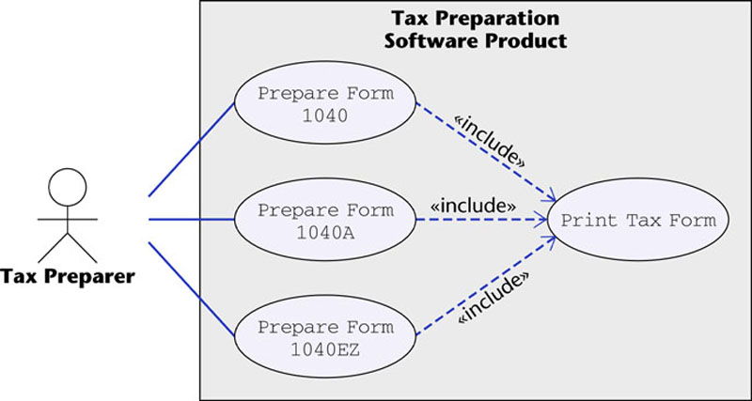
Use-Case Diagrams
Figure 16.12
The McGraw-Hill Companies, 2005

Slide 27
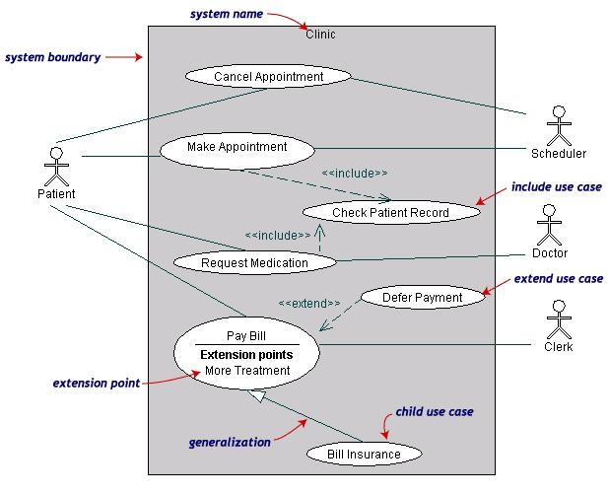
Use-Case Diagrams
Both Make Appointment and Request Medication include Check Patient Record as a subtask (include)
The extension point is written inside the base case Pay bill; the extending class Defer payment adds the behavior of this extension point. (extend)
Pay Bill is a parent use case and Bill Insurance is the child use case. (generalization)
(TogetherSoft, Inc)

